Slide 1
ANOVA - Analysis of Variance
A statistical test used to analyse the difference between the means of more than two groups.
Can be used with data about one categorical independent variable and one quantitative dependent variable. The independent variable should have at least three levels.
Assumptions:
Independence of observations: the data were collected using statistically valid sampling methods, and there are no hidden relationships among observations. If there is a cofounding variable that needed to be controlled for statistically, ANOVA with blocking variables can be used.
Normally-distributed response variable: The values of the dependent variable follow a normal distribution.
Homogeneity of variance: The variation within each group being compared is similar for every group. If the variances are different among the groups, then ANOVA probably isn’t the right fit for the data.
ANOVA null hypothesis is that the mean responses are equal for all treatments. The ANOVA p-value comes from an F-test.
ANOVA will tell if there are differences among the levels of the independent variable, but not which differences are significant. To find how the treatment levels differ from one another, a TukeyHSD post-hoc test needs to be done.

Slide 2
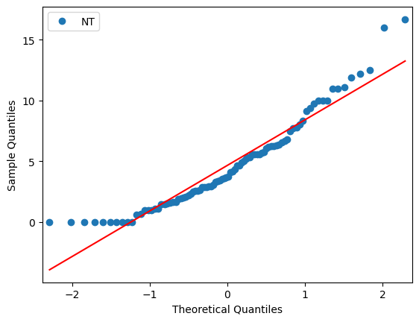
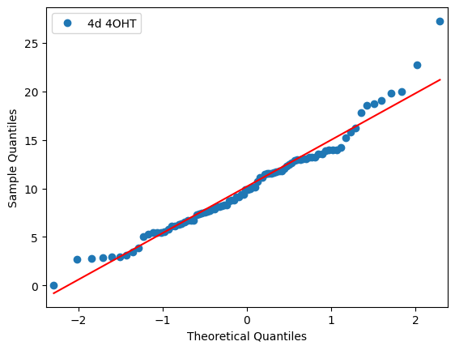
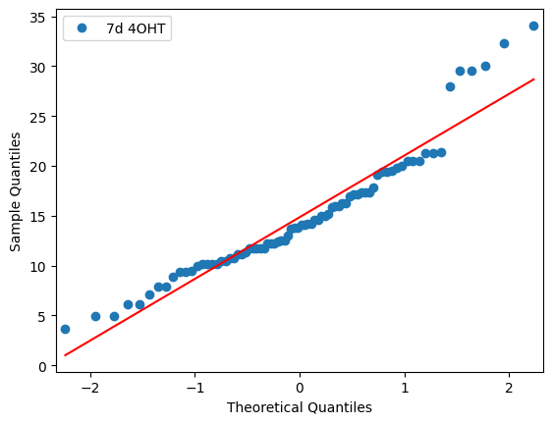
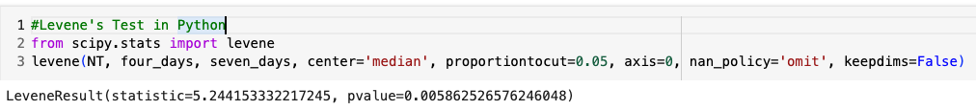
Effect of DNA damage on telomere replication
Should I have used Kruskal-Wallis test?

Slide 3
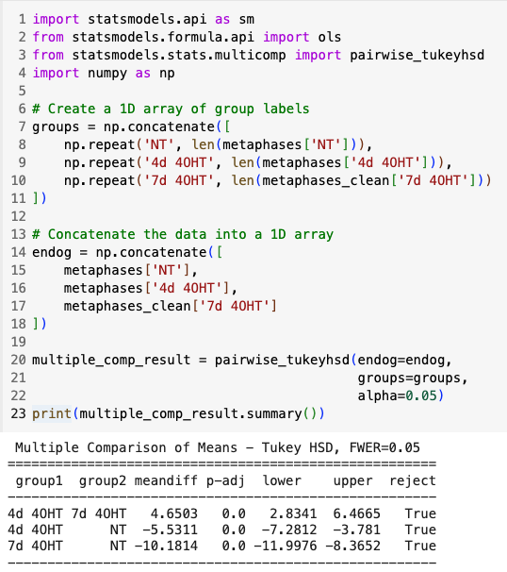
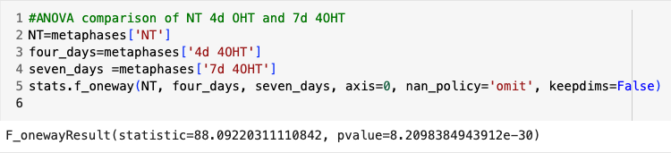
ANOVA test results
The p-value <0.05. Thus, we conclude with a certainty of 95% that there is at least one type of treatment that affects telomeres fragility.

